Slide 1
Static and Dynamic Routing

Slide 2
Reach Remote Networks
A router can learn about remote networks in one of two ways:
Manually - Remote networks are manually entered into the route table using static routes.
Dynamically - Remote routes are automatically learned using a dynamic routing protocol.

Slide 3
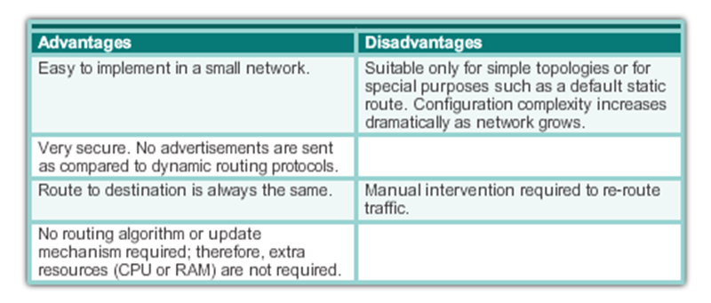
Static Routing

Slide 4
Use of Static Routes
Providing ease of routing table maintenance in smaller networks that are not expected to grow significantly.
Routing to and from stub networks. A stub network is a network accessed by a single route, and the router has no other neighbors.
Using a single default route : Default routes are used to send traffic to any destination beyond the next upstream router.

Slide 5
Static Route Applications
Static Routes are often used to:
Connect to a specific network.
Provide a Gateway of Last Resort for a stub network.
Reduce the number of routes advertised by summarizing several contiguous networks as one static route.
Create a backup route in case a primary route link fails.

Slide 6
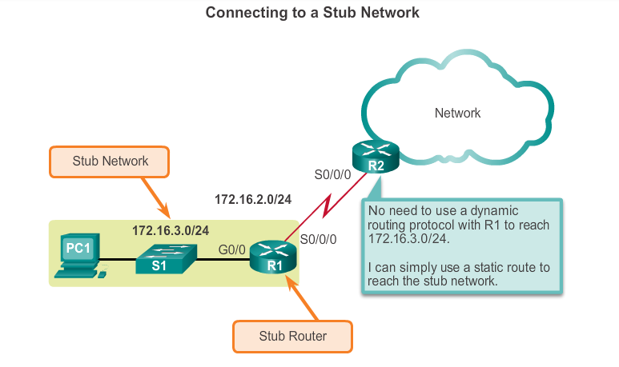
Standard Static Route

Slide 7
Default Static Route
A default static route is a route that matches all packets.
A default route identifies the gateway IP address to which the router sends all IP packets that it does not have a learned or static route.
A default static route is simply a static route with 0.0.0.0/0 as the destination IPv4 address.

Slide 8
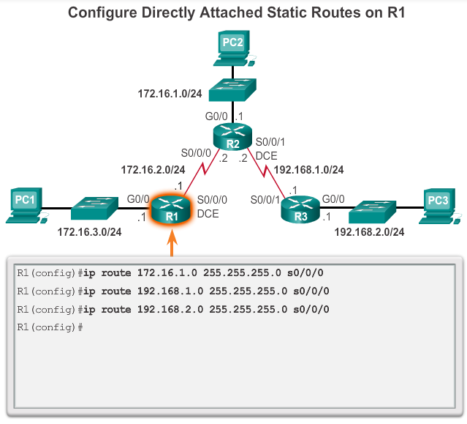
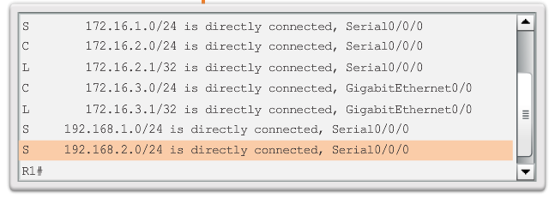
Configure Static Route

Slide 9
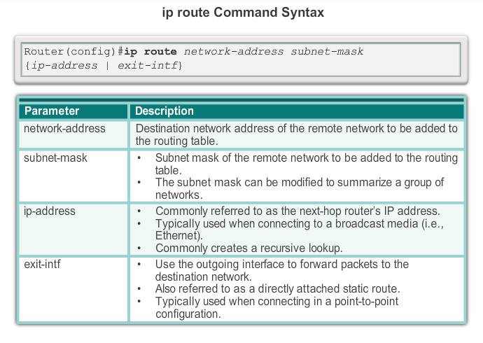
ip route Command to configure
Notes:
6.2.1.1 ip route Command

Slide 10
Verify a Static Route
Along with ping and traceroute, useful commands to verify static routes include:
show ip route
show ip route static
show ip route network

Slide 11
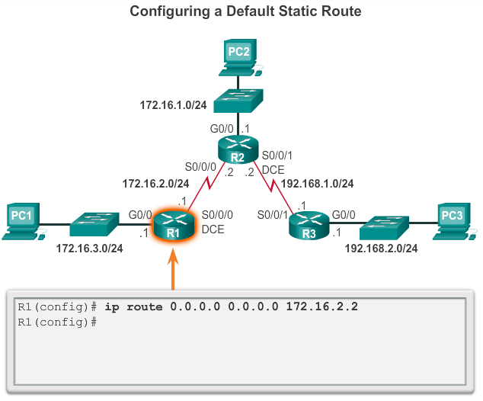
Configure a Default Static Route

Slide 12
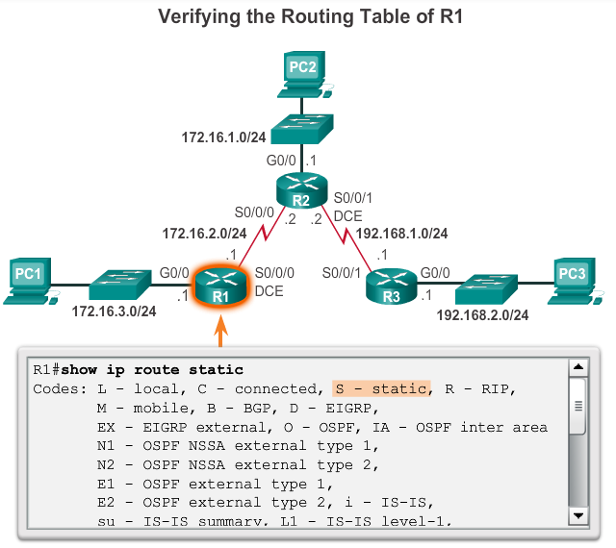
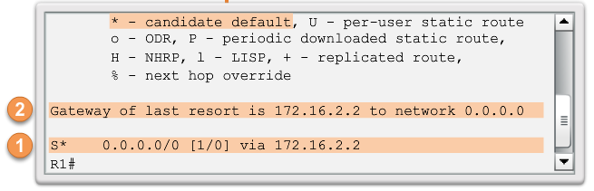
Verify a Default Static Route
Notes:
6.2.2.3 Verify a Default Static Route

Slide 13
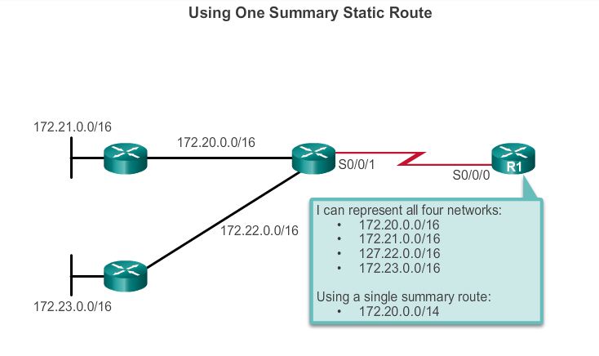
Summary Static Route

Slide 14
Floating Static Routes
Floating static routes are static routes that have an administrative distance greater than the administrative distance of another static route or dynamic routes:
The administrative distance of a static route can be increased to make the route less desirable than that of another static route or a route learned through a dynamic routing protocol.
In this way, the static route “floats” and is not used when the route with the better administrative distance is active.
However, if the preferred route is lost, the floating static route can take over, and traffic can be sent through this alternate route.

Slide 15
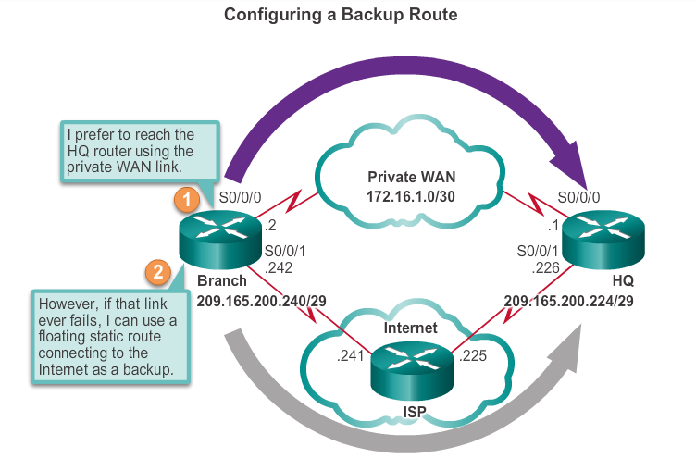
Floating Static Route
Floating static routes are static routes that are used to provide a backup path to a primary static or dynamic route, in the event of a link failure.
The floating static route is only used when the primary route is not available.
To accomplish this, the floating static route is configured with a higher administrative distance than the primary route.

Slide 16
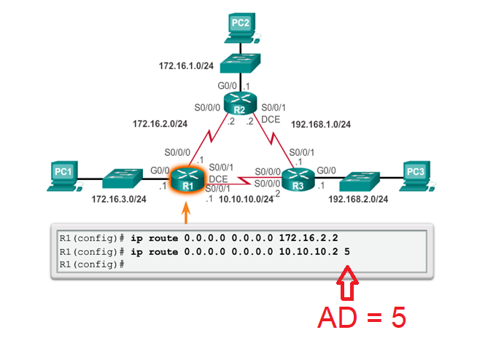
Configure a Floating Static Route

Slide 17
Dynamic Routing Protocols

Slide 18
Purpose of Dynamic Routing Protocols
Routing Protocols are used to facilitate the exchange of routing information between routers.
The purpose of dynamic routing protocols includes:
Discovery of remote networks
Maintaining up-to-date routing information
Choosing the best path to destination networks
Ability to find a new best path if the current path is no longer available

Slide 19
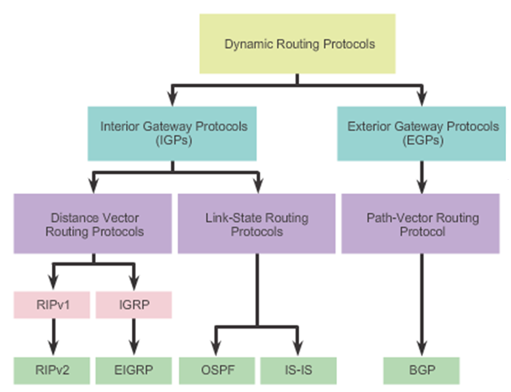
Classifying Routing Protocols

Slide 20
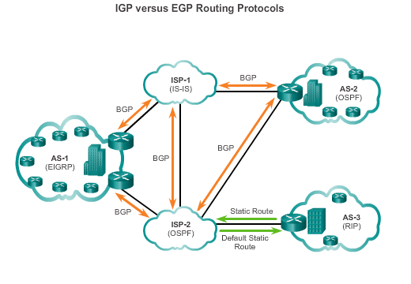
IGP and EGP Routing Protocols
Interior Gateway Protocols (IGP) -
Used for routing within an AS
Include RIP, EIGRP, OSPF, and IS-IS
Exterior Gateway Protocols (EGP) -
Used for routing between AS
Official routing protocol used by the Internet

Slide 21
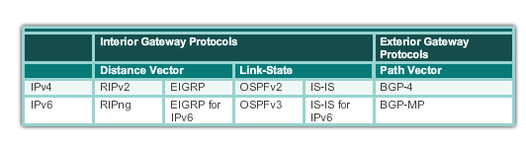
Dynamic Routing Protocols
Dynamic routing protocols used in networks since the late 1980s
Newer versions support the communication based on IPv6

Slide 22
Components of Dynamic Routing Protocols
Data structures - Routing protocols typically use tables or databases for its operations. This information is kept in RAM.
Routing protocol messages - Routing protocols use various types of messages to discover neighboring routers, exchange routing information, and other tasks to learn and maintain accurate information about the network.
Algorithm - Routing protocols use algorithms for facilitating routing information for best path determination.
Notes:
7.1.1.2 Purpose of Dynamic Routing Protocols (cont.)

Slide 23
The Role of Dynamic Routing Protocols
Advantages
Automatically share information about remote networks
Determine the best path to each network and add this information to their routing tables
Compared to static routing, dynamic routing protocols require less administrative overhead
Help the network administrator manage the time-consuming process of configuring and maintaining static routes
Disadvantages :
Part of a router’s resources are dedicated for protocol operation, including CPU time and network link bandwidth
Times when static routing is more appropriate
Notes:
7.1.1.3 The Role of Dynamic Routing Protocols

Slide 24
Dynamic Routing Protocol Operation
The router sends and receives routing messages on its interfaces.
The router shares routing messages and routing information with other routers that are using the same routing protocol.
Routers exchange routing information to learn about remote networks.
When a router detects a topology change the routing protocol can advertise this change to other routers.

Slide 25
Routing Protocol Metrics
A metric is a measurable value that is assigned by the routing protocol to different routes based on the usefulness of that route:
Used to determine the overall “cost” of a path from source to destination.
Routing protocols determine the best path based on the route with the lowest cost.
RIP: Hop count is the metric
OSPF: Bandwidth

Slide 26
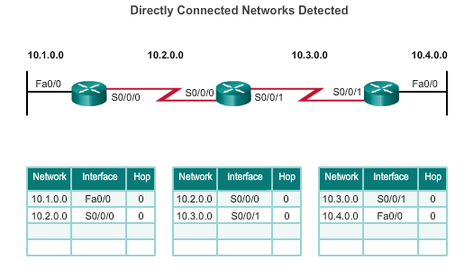
Routing Protocol Operating Fundamentals Cold Start
Routers running RIPv2
All routers have the information of their own interfaces which are directly connected

Slide 27
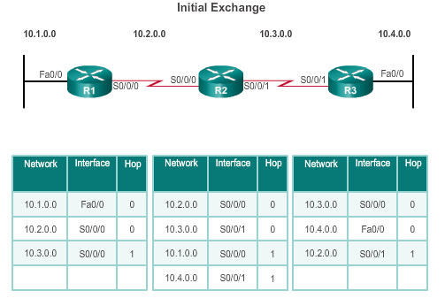
Network Discovery
Router R1:
Sends an update about network 10.1.0.0 out the Serial0/0/0 interface
Sends an update about network 10.2.0.0 out the FastEthernet0/0 interface
Receives update from R2 about network 10.3.0.0 with a metric of 1
Stores network 10.3.0.0 in the routing table with a metric of 1
Routers running RIPv2

Slide 28
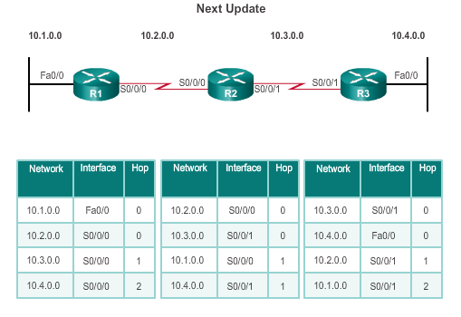
Exchanging the Routing Information
Router R1:
Sends an update about network 10. 1. 0. 0 out the Serial 0/0/0 interface
Sends an update about networks 10. 2. 0. 0 and 10. 3. 0. 0 out the FastEthernet0/0 interface
Receives an update from R2 about network 10. 4. 0. 0 with a metric of 2
Stores network 10. 4. 0. 0 in the routing table with a metric of 2
Same update from R2 contains information about network 10. 3. 0. 0 with a metric of 1. There is no change; therefore, the routing information remains the same
Routers running RIPv2

Slide 29
Achieving Convergence
The network is converged when all routers have complete and accurate information about the entire network:
Convergence time is the time it takes routers to share information, calculate best paths, and update their routing tables.
A network is not completely operable until the network has converged.
Convergence properties include the speed of propagation of routing information and the calculation of optimal paths. The speed of propagation refers to the amount of time it takes for routers within the network to forward routing information.
Generally, older protocols, such as RIP, are slow to converge, whereas modern protocols, such as EIGRP and OSPF, converge more quickly.

Slide 30
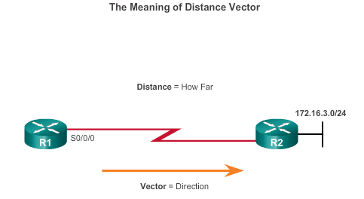
Distance Vector Routing Protocols: Examples
Distance vector IPv4 IGPs:
RIPv1 - First generation legacy protocol
RIPv2 - Simple distance vector routing protocol
IGRP - First generation Cisco proprietary protocol (obsolete)
EIGRP - Advanced version of distance vector routing
For R1, 172.16.3.0/24 is one hop away (distance). It can be reached through R2 (vector).

Slide 31
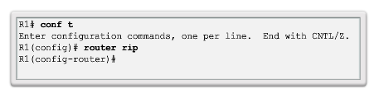
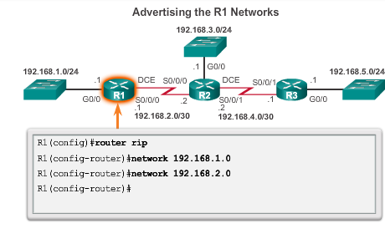
Router RIP Configuration

Slide 32
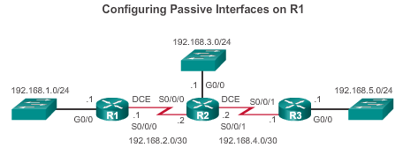
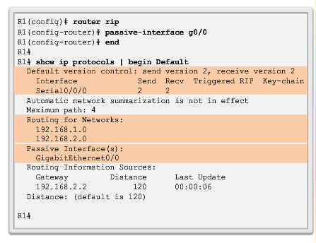
Configuring the RIP Protocol Configuring Passive Interfaces
Sending out unneeded updates on a LAN impacts the network in three ways:
Wasted Bandwidth
Wasted Resources
Security Risk

Slide 33
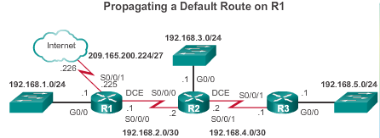
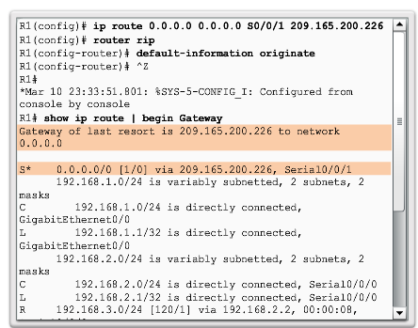
Configuring the RIP Protocol Propagating a Default Route

Slide 34
Example: DV routing
A
B
C
A
0
D
0
B
C
A
D
E
1
A
D
2
B
E
C
10
2
E
D
E
0
2
B
C
A
A
B
0
B
C
Initialization
C
0
D
D
E
E

Slide 35
A
1
A
0
B
B
10
C
2
C
D
0
D
1
D
E
2
A
A
E
1
2
B
C
2
10
2
E
D
2
E
0
2
B
C
A
10
A
B
0
B
C
Direct
Neighbours
C
0
D
2
D
E
2
E

Slide 36
A
1
A
0
B
11
B
10
C
2
C
3
D
0
D
1
D
E
2
A
A
3
E
3
1
2
B
C
2
10
2
E
D
2
E
0
2
B
C
A
10
3
A
B
0
Neighbours
of neighbours
B
C
C
0
D
11
2
D
E
2
E

Slide 37
A
1
A
0
B
11
B
10
C
2
C
3
D
0
D
1
D
E
2
A
A
3
E
3
1
2
B
13
C
2
10
2
E
D
2
E
0
2
B
C
A
10
3
A
Neighbours
of neighbours
of neighbours
B
0
B
13
C
13
C
0
D
11
2
D
E
13
E
2

Slide 38
A
1
A
0
B
11
B
10
C
2
C
3
D
0
D
1
D
E
2
A
A
3
E
3
1
2
B
13
C
2
10
2
E
D
2
E
0
2
B
C
A
10
3
A
B
0
Stable
convergence
B
13
C
13
C
0
D
11
2
D
E
13
E
2

Slide 39
A
1
A
0
B
11
B
10
C
2
C
3
D
0
D
1
D
E
2
A
A
3
E
3
1
2
B
13
C
2
10
2
E
D
2
E
0
2
B
1
C
A
10
3
A
Good news:
A new link!
B
0
B
13
C
13
C
0
D
11
2
D
E
13
E
2

Slide 40
A
1
A
0
B
11
B
10
C
2
C
3
D
0
D
1
D
E
2
A
A
3
E
3
1
2
B
13
C
2
10
2
E
D
2
E
0
2
B
1
C
A
10
3
A
B
0
Direct
endpoints
know
B
1
C
1
C
0
D
11
2
D
E
13
E
2

Slide 41
A
1
A
0
B
3
B
10
C
2
C
3
D
0
D
1
D
E
2
A
A
3
E
3
1
2
B
3
C
2
10
2
E
D
2
E
0
2
B
1
C
A
4
3
A
B
0
Neighbours
know
B
1
C
1
C
0
D
3
2
D
E
3
E
2

Slide 42
A
1
A
0
B
3
B
4
C
2
C
3
D
0
D
1
D
E
2
A
A
3
E
3
1
2
B
3
C
2
10
2
E
D
2
E
0
2
B
1
C
A
4
3
A
Neighbours
of neighbours
know
B
0
B
1
C
1
C
0
D
3
2
D
E
3
E
2

Slide 43
A
1
A
0
B
3
B
4
C
2
C
3
D
0
D
1
D
E
2
A
A
3
E
3
1
2
B
3
C
2
10
2
E
D
2
E
0
2
B
1
C
A
4
3
A
B
0
A happy and
stable network
B
1
C
1
C
0
D
3
2
D
E
3
E
2

Slide 44
A
1
A
0
B
3
B
4
C
2
C
3
D
0
D
1
D
E
2
A
A
3
E
3
1
2
B
3
C
2
10
2
E
D
2
E
0
2
B
C
A
4
3
A
Bad news:
Link crash!!
B
0
B
1
C
1
C
0
D
3
2
D
E
3
E
2

Slide 45
A
1
A
0
B
3
B
4
C
2
C
3
D
0
D
1
D
E
2
A
A
3
E
3
1
2
B
3
C
2
10
2
E
D
2
E
0
2
B
C
A
3
A
Direct
endpoints
know
B
0
B
C
C
0
D
2
D
E
2
E

Slide 46
A
1
A
0
B
3
B
4
C
2
C
3
D
0
D
1
D
E
2
A
A
3
E
3
1
2
B
3
C
2
10
2
E
D
2
E
0
2
10
B
C
A
3
A
B
0
B
C
C
0
D
2
D
E
2
E

Slide 47
A
1
A
0
B
3
B
4
C
2
C
3
D
0
D
1
D
E
2
A
A
3
E
3
1
2
B
3
C
2
10
2
E
D
2
E
0
2
10
B
C
A
3
A
Get help
from
neighbours
B
0
B
5
C
13
C
0
D
11
D
2
E
13
2
E

Slide 48
A
1
A
0
B
7
B
4
C
2
C
3
D
0
D
1
D
E
2
A
A
3
E
3
1
2
B
7
C
2
10
2
E
D
2
E
0
2
10
B
C
A
3
A
Routing loop
(due to
inconsistent
state info)
B
0
B
5
C
13
C
0
D
11
D
2
E
13
2
E

Slide 49
Problem of DV Routing: Count-to-Infinity
Count-to-Infinity problem
Counting to infinity is just another name for a routing loop.
In distance vector routing, routing loops usually occur when an interface goes down.
It can also occur when two routers send updates to each other at the same time.

Slide 50
A
1
A
0
B
7
B
8
C
2
C
3
D
0
D
1
D
E
2
A
A
3
E
3
1
2
B
7
C
2
10
2
E
D
2
E
0
2
10
B
C
A
3
A
B
0
B
9
C
13
C
0
D
11
D
2
E
13
2
E

Slide 51
A
1
A
0
B
11
B
8
C
2
C
3
D
0
D
1
D
E
2
A
A
3
E
3
1
2
B
11
C
2
10
2
E
D
2
E
0
2
10
B
C
A
3
A
B
0
Counting
to infinity…
B
9
C
13
C
0
D
11
D
2
E
13
2
E

Slide 52
A
1
A
0
B
11
B
10
C
2
C
3
D
0
D
1
D
E
2
A
A
3
E
3
1
2
B
11
C
2
10
2
E
D
2
E
0
2
10
B
C
A
3
A
B
0
B
13
C
13
C
0
D
11
D
2
E
13
2
E

Slide 53
A
1
A
0
B
11
B
10
C
2
C
3
D
0
D
1
D
E
2
A
A
3
E
3
1
2
B
13
C
2
10
2
E
D
2
E
0
2
10
B
C
A
3
A
B
0
B
13
C
13
C
0
D
11
D
2
E
13
2
E

Slide 54
A
1
A
0
B
11
B
10
C
2
C
3
D
0
D
1
D
E
2
A
A
3
E
3
1
2
B
13
C
2
10
2
E
D
2
E
0
2
10
B
C
A
3
A
B
0
Stability
again
B
13
C
13
C
0
D
11
D
2
E
13
2
E

Slide 55
Loop Breaking Heuristics
Set infinity to a limited number, e.g. 16.
Split horizon
Split horizon with poison reverse

Slide 56
Link State Routing Protocols

Slide 57
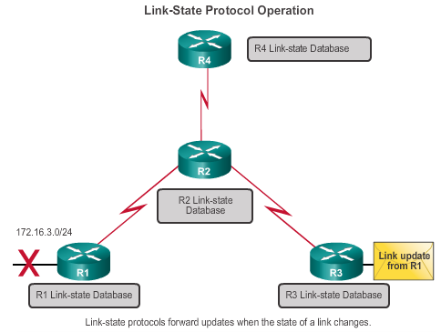
Link-State Routing Protocols
Link-state IPv4 IGPs:
OSPF - Popular standards based routing protocol
IS-IS - Popular in provider networks.

Slide 58
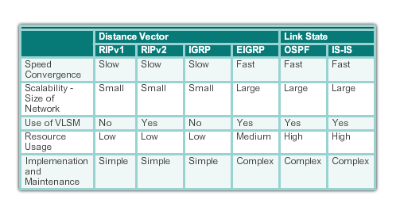
Routing Protocol Characteristics

Slide 59
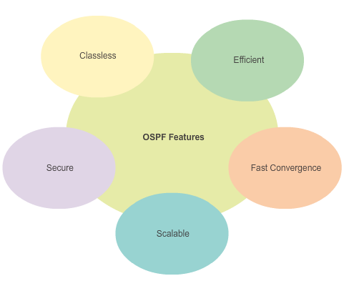
Open Shortest Path First Features of OSPF

Slide 60
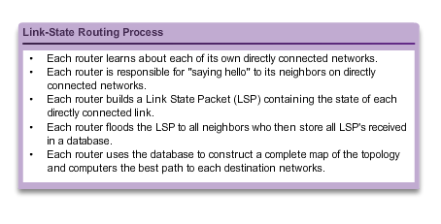
Link-State Routing Process

Slide 61
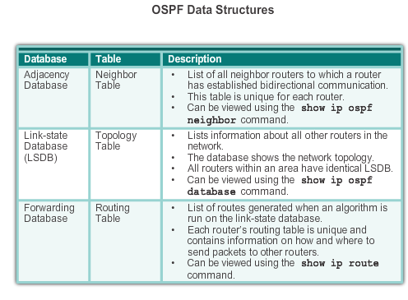
Components of OSPF

Slide 62
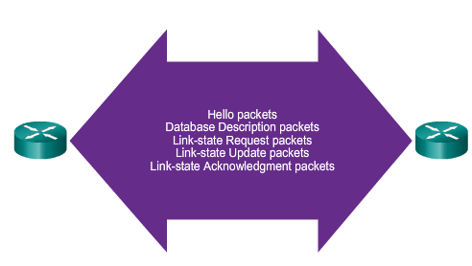
Components of OSPF
OSPF Routers Exchange Packets - These packets are used to discover neighboring routers and also to exchange routing information to maintain accurate information about the network.

Slide 63
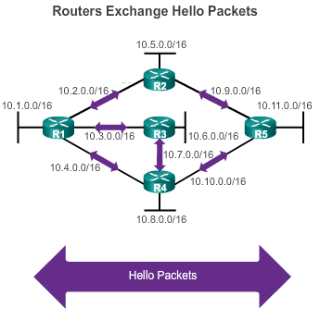
Hello Exchange
If a neighbor is present, the OSPF-enabled router attempts to establish a neighbor adjacency with that neighbor

Slide 64
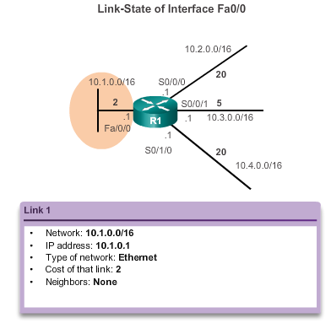
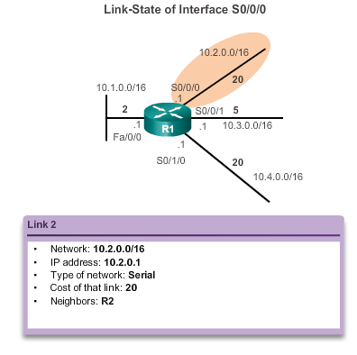
Link and Link-State
The first step in the link-state routing process is that each router learns about its own links and its own directly connected networks.

Slide 65
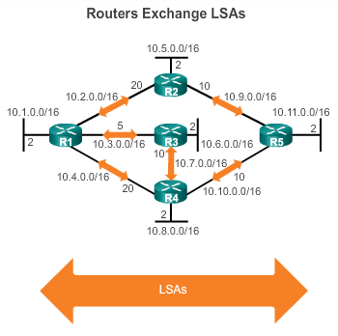
Exchange of LSA
LSAs contain the state and cost of each directly connected link.
Routers flood their LSAs to adjacent neighbors.
Adjacent neighbors receiving the LSA immediately flood the LSA to other directly connected neighbors, until all routers in the area have all LSAs.

Slide 66
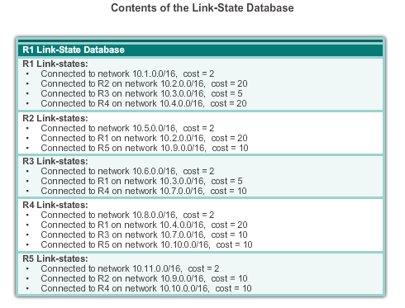
Building the Link-State Database
The final step in the link-state routing process is that each router uses the database to construct a complete map of the topology and computes the best path to each destination network.

Slide 67
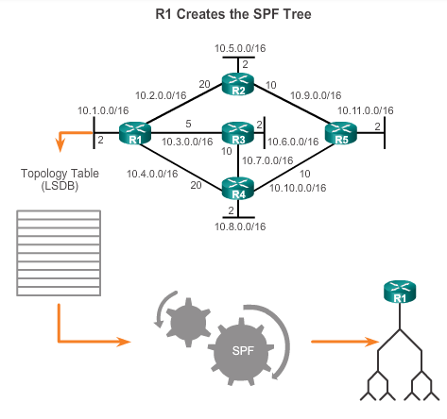
Creating SPF Tree
Build the topology table based on the received LSAs.
This database eventually holds all the information about the topology of the network.
Execute the SPF Algorithm.

Slide 68
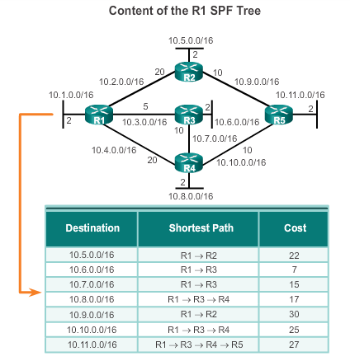
SPF Tree to best path Calculation
From the SPF tree, the best paths are inserted into the routing table.

Slide 69
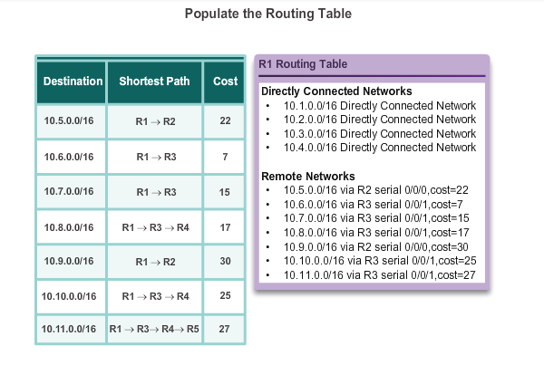
Adding OSPF Routes to the Routing Table

Slide 70
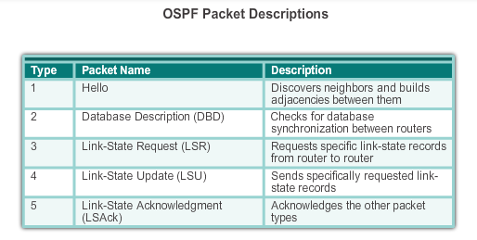
OSPF Messages Types of OSPF Packets

Slide 71
Hello Packet
OSPF Type 1 packet = Hello packet:
Discover OSPF neighbors and establish neighbor adjacencies.
Advertise parameters on which two routers must agree to become neighbors.
Elect the Designated Router (DR) and Backup Designated Router (BDR) on multiaccess networks like Ethernet and Frame Relay.

Slide 72
Hello Packet Intervals
OSPF Hello packets are transmitted:
To 224.0.0.5 in IPv4 and FF02::5 in IPv6 (all OSPF routers)
Every 10 seconds (default on multiaccess and point-to-point networks)
Every 30 seconds
Dead interval is the period that the router waits to receive a Hello packet before declaring the neighbor down
Router floods the LSDB with information about down neighbors out all OSPF enabled interfaces

Slide 73
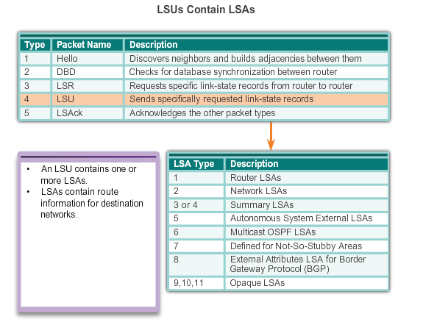
Link-State Updates

Slide 74
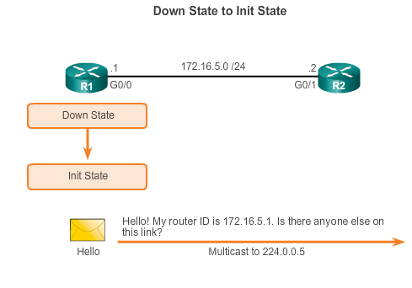
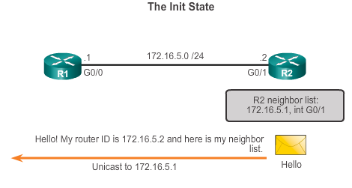
Establish Neighbor Adjacencies

Slide 75
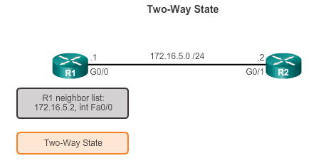
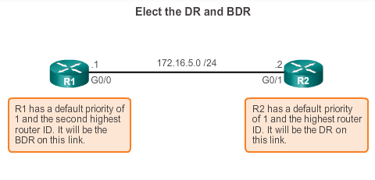
OSPF Operation Establish Neighbor Adjacencies (cont.)
DR and BDR election only occurs on multi-access networks such as Ethernet LANs.

Slide 76
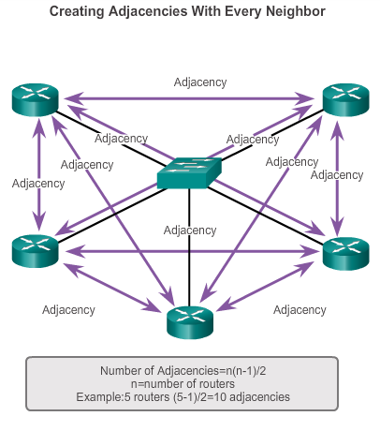
OSPF DR and BDR

Slide 77
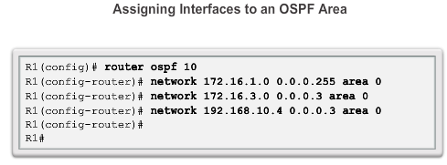
Configure Single-area OSPFv2

Slide 78
Single vs. Multi-Area OSPF

Slide 79
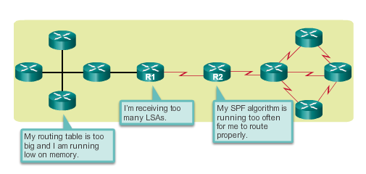
Why Multiarea OSPF? Single-Area OSPF
Single-area OSPF is useful in smaller networks. If an area becomes too big, the following issues must be addressed:
Large routing table (no summarization by default)
Large link-state database (LSDB)
Frequent SPF algorithm calculations

Slide 80
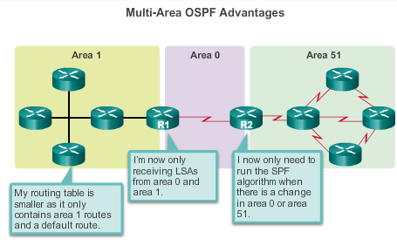
Why Multiarea OSPF? Multiarea OSPF
Multiarea OSPF requires a hierarchical network design and the main area is called the backbone area, or area 0, and all other areas must connect to the backbone area.

Slide 81
OSPF Two-Layer Area Hierarchy
Multiarea OSPF is implemented in a two-layer area hierarchy:
Backbone (transit) area
Area whose primary function is the fast and efficient movement of IP packets.
Interconnects with other OSPF area types.
Called OSPF area 0, to which all other areas directly connect.
Regular (nonbackbone) area
Connects users and resources.
A regular area does not allow traffic from another area to use its links to reach other areas.

Slide 82
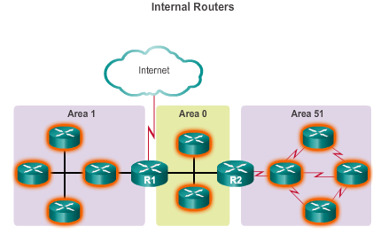
Types of OSPF Routers

Slide 83
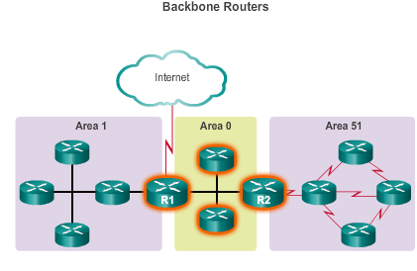
Types of OSPF Routers (cont.)

Slide 84

Types of OSPF Routers (cont.)

Slide 85

Why Multiarea OSPF? Types of OSPF Routers (cont.)
Notes:
6.1.1.4 Types of OSPF Routers

Slide 86
Configuring Multi Area OSPF

Slide 87


Configuring Multiarea OSPF

Slide 88
Verifying Multiarea OSPF
The same verification commands are used to verify single-area OSPF and can be used to verify multiarea OSPF:
show ip ospf neighbor
show ip ospf
show ip ospf interface
Commands specific to multiarea information include:
show ip protocols
show ip ospf interface brief
show ip route ospf
show ip ospf database

